Slide 1


OpenSim – Python
Hernandez Vincent

Slide 2

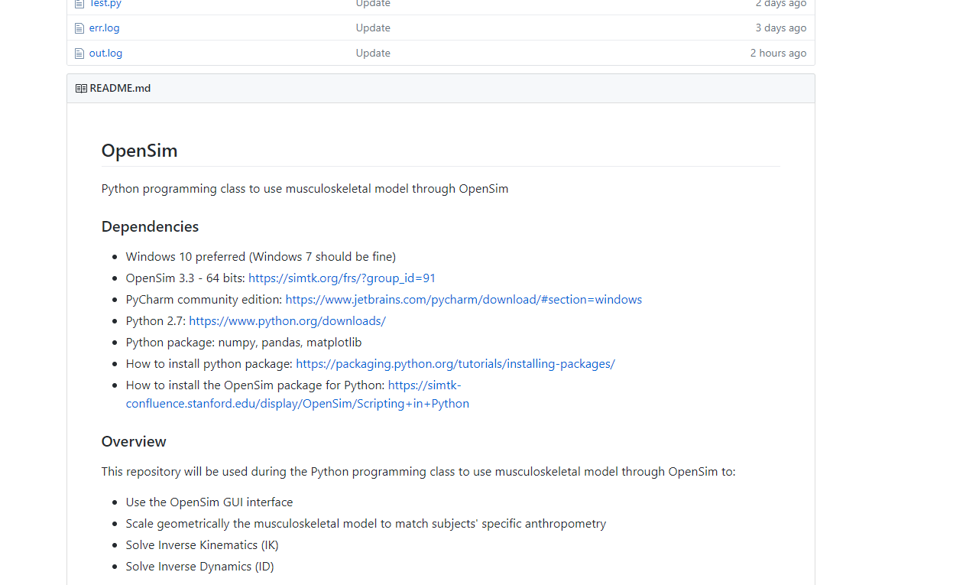
2
GitHub repository
GitHub repository:
https://github.com/GVLABHernandez/OpenSim

Slide 3
3
Inverse Dynamics in OpenSim

Slide 4
4
Run your first Inverse Dynamics
Go to the opensim-master folder and create two new folder:
STO
STO_temp

Slide 5
5
Run your first Inverse Dynamics
Go the PFF_MOT file and open it in Excel
The first columns represent the time
force_vx force_vy force_vz represent the force vector measured by the force plate
force_px force_py force_pz represent the point of force application in the global reference system

Slide 6
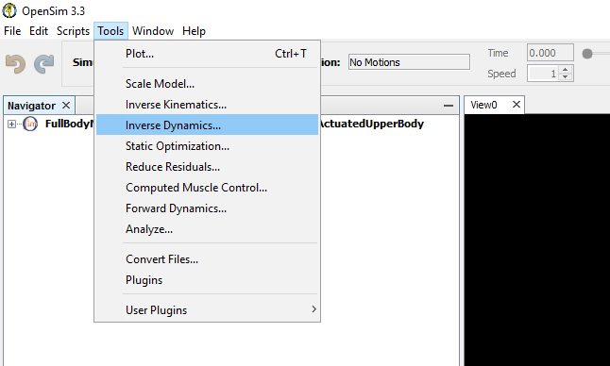
6
Run your first Inverse Dynamics

Slide 7
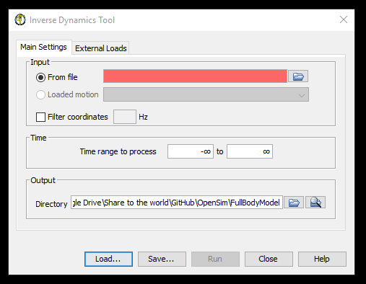
7
Run your first Inverse Dynamics
Select the Walk_Mkrs.mot file created from the IK in the MOT folder

Slide 8
8
Run your first Inverse Dynamics
Then, go to External Loads

Slide 9
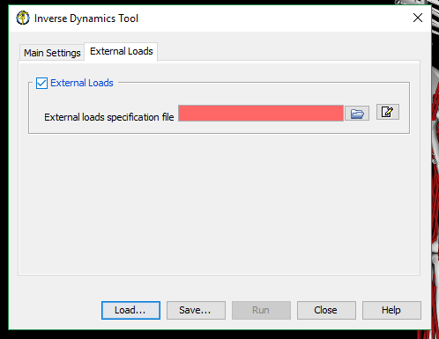
9
Run your first Inverse Dynamics
Enable External Loads and then go to edit

Slide 10
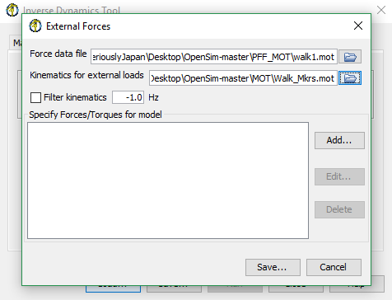
10
Run your first Inverse Dynamics
Load the Force data file walk1.mot in the PFF_MOT folder and Walk_Mkrs.mot file created from the IK in the MOT folder

Slide 11
11
Run your first Inverse Dynamics
Then, click on Add…

Slide 12
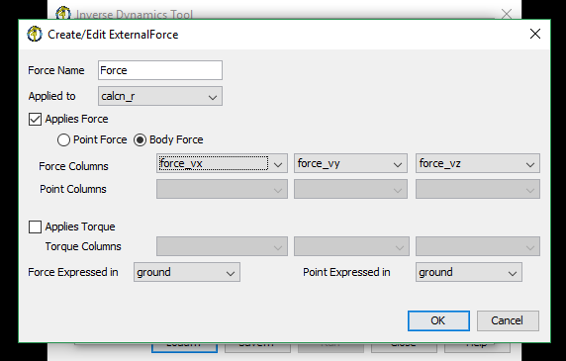
12
Run your first Inverse Dynamics
Create/Edit the external force properties

Slide 13
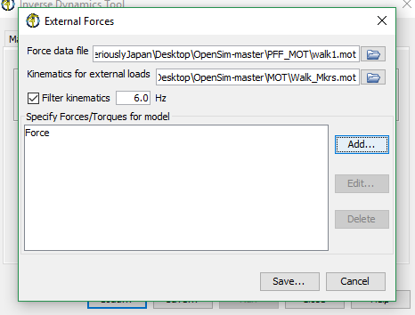
13
Run your first Inverse Dynamics
Save the XML files in the XML folder and name it ID_test

Slide 14
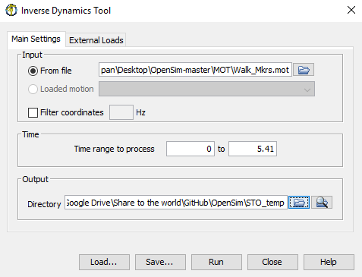
14
Run your first Inverse Dynamics
Select the output directory: STO_temp in the opensim-master folder

Slide 15
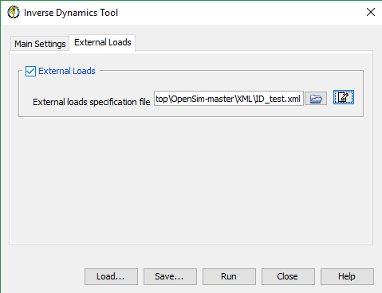
15
Run your first Inverse Dynamics
Then click on run

Slide 16
16
Plot the results in Excel
Open inverse_dynamics.sto file that contain the ID results with Excel
Create one graph with ankle_angle_r_moment

Slide 17
17
Inverse Dynamics with Python

Slide 18
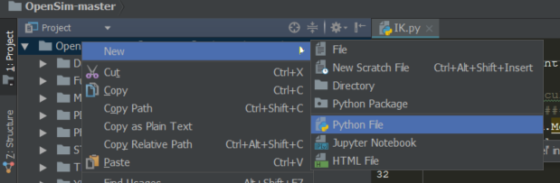
18
OpenSim-master project
Create a new python script
Name it ID.py

Slide 19
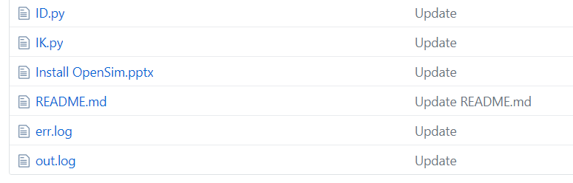
19
GitHub repository
GitHub repository:
https://github.com/GVLABHernandez/OpenSim
Open the ID.py file

Slide 20
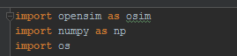
20
ID.py
This part of the code is used to import the needed libraries
OpenSim: API to connect python and OpenSim
Numpy: use to multi-dimensional arrays and matrices. Large collection of mathematical functions

Slide 21
21
ID.py
Change the dir_path that correspond to the path where your opensim-master project is
Replace the \ or ¥ with \\ or ¥ ¥

Slide 22
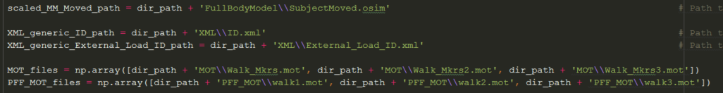
22
ID.py
scaled_MM_Moved_path: path to the musculoskeletal model
XML_generic_ID_path: path to the generic Inverse Dynamics.XML file
MOT_files: path to the .MOT file in the MOT file (contain the IK results)
PFF_MOT_files: path to the .MOT file that contain the force data from the force plate

Slide 23

23
ID.py
osimModel: We use the path to the musculoskeletal model to create the musculoskeletal model in Python
state: use to initialize the model. This must be called after the Model is fully created but before starting a simulation.

Slide 24
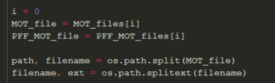
24
ID.py
MOT_file: take the first element of MOT_files[i] with i = 0
PFF_MOT_file: take the first element of PFF_MOT_filess[i] with i = 0
os.path.split(MOT_file) and os.path.splitext(filename): use to separate the path, the filename and the extension
Example: 'MOT\\Walk_Mkrs.mot‘ will be separated in MOT‘, 'Walk_Mkrs and '.mot‘
MOT_file: name of the .mot file that will contain the result of the IK
XML_IK_file: name of the .xml configuration file that will be used to run the IK

Slide 25
25
ID.py
STO_file: name of the .sto file that will contain the result of the ID
XML_ID_file: name of the .xml configuration file that will be used to run the ID
XML_External_Load_ID_file: .xml configuration file that cill contain all the information related to the force orientation, point of force application, body of force application, reference system of the force

Slide 26
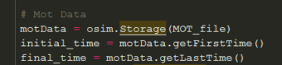
26
ID.py
This part is used to take the information that are contain in the .mot file (data that contain the IK result) and decide from what time to what time the simulation should be performed.
Here we choose to run the simulation between the first (getStartFrameTime) and the last frame (getLastFrameTime)

Slide 27
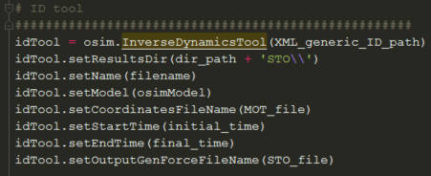
27
ID.py
Create the idTool, that correspond to the Inverse Dynamics Tool class from OpenSim.
setResultsDir() where we want the results to be store
setName(): the name of the results we want
setModel(osimModel): which musculoskeletal model will be used
setCoordinatesFileName(): the file that contain the IK results

Slide 28
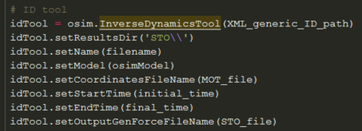
28
ID.py
Set from what time to what time the simulation should be performed: setStartTime(initial_time)
setEndTime(final_time)
Set the name of the file that will contain the result of the ID: setOutputGenForceFileName()

Slide 29

29
ID.py
Create the externalLoads, that will be used to add the information from the force plate in the idTool: osim.ExternalLoads(osimModel, XML_generic_External_Load_ID_path)
setName(): the name of the results we want
setDataFileName(): path to the file that contain the force data
setLowpassCutoffFrequencyForLoadKinematics(): set the butter low pass filter values (the results can be very noisy without it)

Slide 30
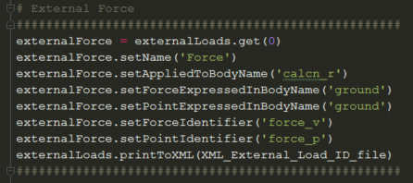
30
ID.py

Slide 31
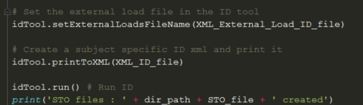
31
ID.py

